Slide 1

NAKUJA PROJECT N-2 BENCHMARKING OF ROCKET MODELS.
Benchmarking of rocket models of approx. 1km apogee.

Slide 2

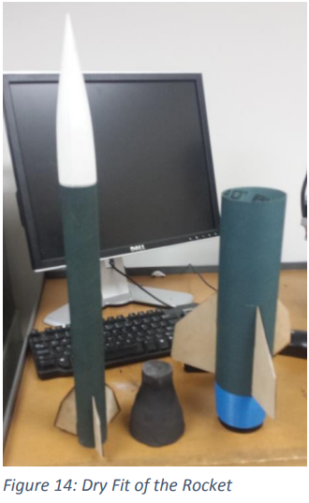
R2: Wisconsin-madison
Altitude: 1554 m
SIZE AND MASS:
Length: 63.25 cm
Dart diameter: 38mm
Booster diameter: 76 mm
Mass: unknown
Material: Fiberglass
MOTOR CHOICE:
Cesaroni 475-I445-16A.
Max acceleration: 244 m/s
PARTS:
Dart
Transition
Booster
RECOVERY SYSTEM:
Dart-609.6 mm parachute with descent rate of 6.096 m/s
Booster – 762 mm parachute with descent rate of 6.096 m/s

Slide 3
FINS:
Booster fins surface area: 143.23 square cm
Dart fins surface area: 44.77 square cm
AVIONICS:
Data Acquisition: MPU6050 6-axis accelerometer/gyro
Xtrinsic MPL3115A2 altimeter
Data Logging: a microSD card - This device communicates on an SPI bus which allows for straightforward prototyping and connection to most microprocessors
Data Logging: the flight vehicle transmits at 100 Hz a copy of all data written to the SD card. This data is received by a ground-based antenna connected to an identical transceiver, which then passes the data to a laptop computer where it is logged and graphically displayed. two 900 MHz Xbee’s were chosen – one for the vehicle and one for the ground station
On the ground, a laptop processes and displays the attitude data in 3D using a custom LabVIEW program.

Slide 4
Anticipated Rocket Performance:
The dart is projected to reach a total altitude of : 1554 m, with a max velocity of 213.4 m/s and a max acceleration of 244 m/s2.
The booster is projected to reach an altitude of 335m. The max velocity of the booster is projected as 213.4 m/s and the max acceleration as 244 m/s2 .
Rocket Construction:
Fins and Centering Rings : an Epilog Mini 18 Laser Cutter was used to laser cut out the fins, centering rings, bulk heads, and electronic bay components.
Boat Tail: 3D printed on a Dimension Elite 3D printer using ABS plastic.
Transition and Dart Tail Cone: constructed using fiberglass molding.
Body Tubing: cut to length on a horizontal band saw and then squared on a lathe.

Slide 5
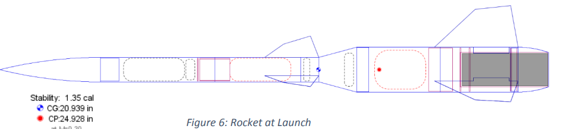
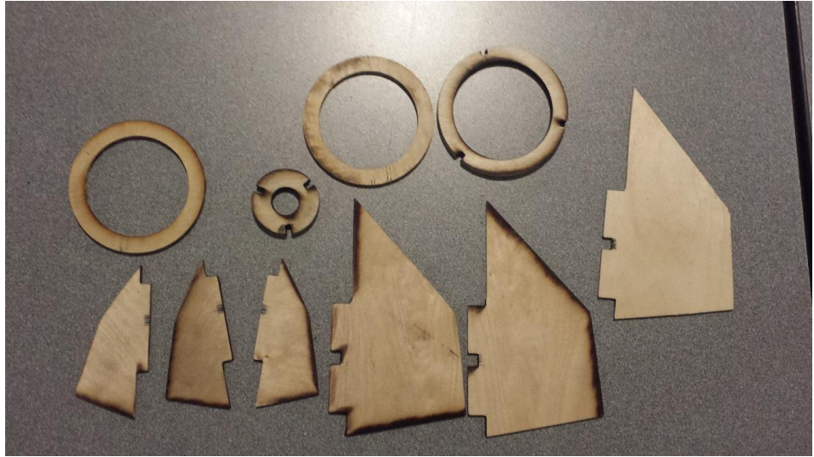
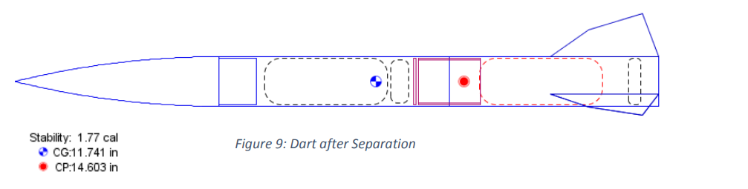
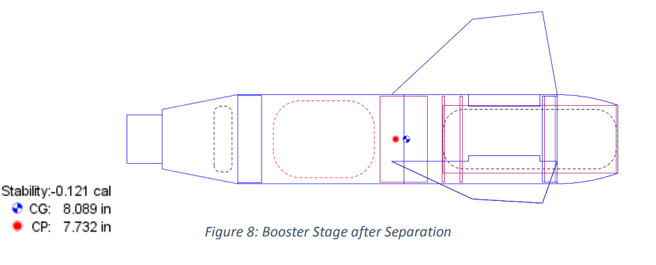
Laser cut fins and centering rings

Slide 6

Thank You!
Ogweno Emmanuel

